Slide 1
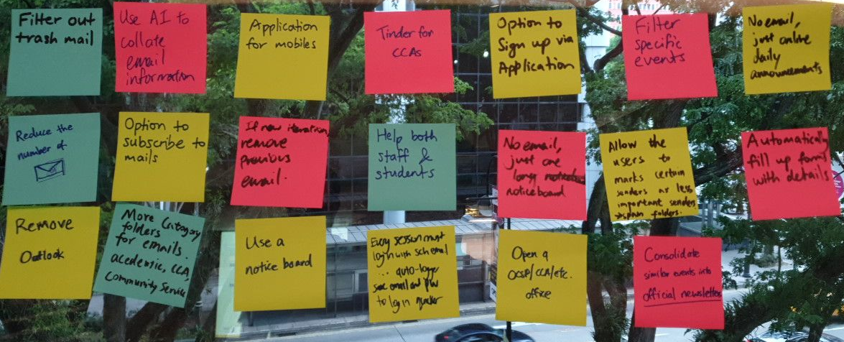
SMOOBOARD
Singapore Management University
25 Sep 2019
Matthew
Tan
Lau
You Xing
Verdant
Yibing
Chen
Qing Hong Ji
Charmaine
Group
7

Slide 2


How did we find participants & What
breakdown did we find?
What is the problem
and solution?
How it feel and What usability problems after evaluation
What scenarios and personas we wrote
What does prototype look like?

Slide 3





Problems
Excessive & Repetitive Emails
Unaware of school events

Slide 4




Slide 5





Participants
SMU students
18-25 years old
Freshmen
Sophomore
OCSP leader
CCA Exco

Slide 6



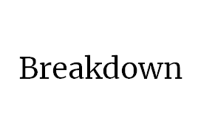





Slide 7
Students don’t read every email
Goals
To ensure important emails are read
To sort or prioritize emails
Issues
Excessive emails
Students skim through their emails
May miss out on important / relevant emails

Slide 8
Information regarding non-academic activities difficult to obtain
Goals
To find information regarding a specific non-academic initiatives
Issues
Excessive emails especially from non-academic activities
Lack of single platform for students to find out more on current available CCA, OCSPs, etc

Slide 9
Backlog of obsolete events
Goals
To find out more about current and upcoming events
Issues
Emails get buried with the constant inflow
Some students do not check their mail often, others skimmed through might cause them to miss the event
Emails of events that are over, remained in students’ inbox

Slide 10
Personas

Slide 11
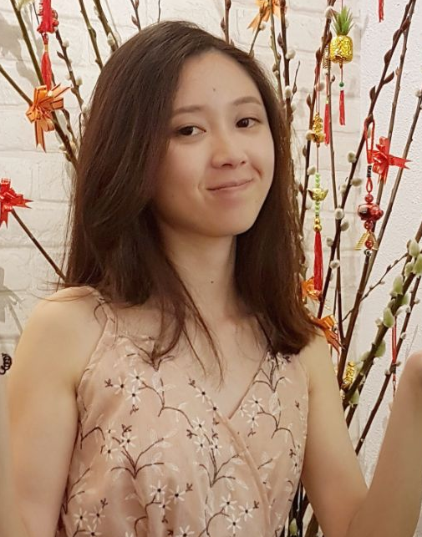
Name: Jocelyn | Age: 24 | Major: Econs | Sophomore
Bio: “Push yourself, because no one is gonna do it for you”
Motivation: Graduate with summa cum laude, vibrant school life and expanding her social circle.

Slide 12
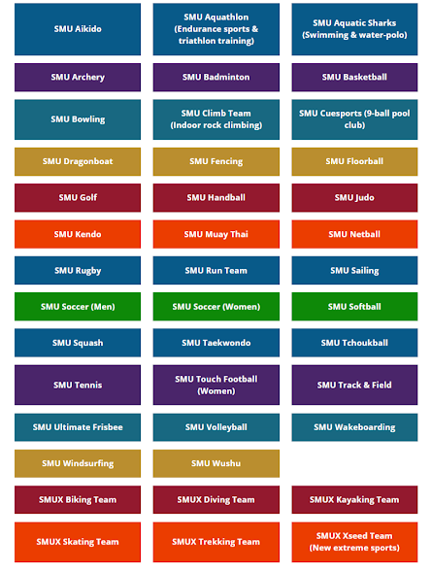

Goals
Join a low commitment CCA
Be more involved in school activities
Frustrations
Excessive emails
Too little information provided
SMU website provide a list of CCA but not much information is given
Spent too much time researching on CCA

Slide 13
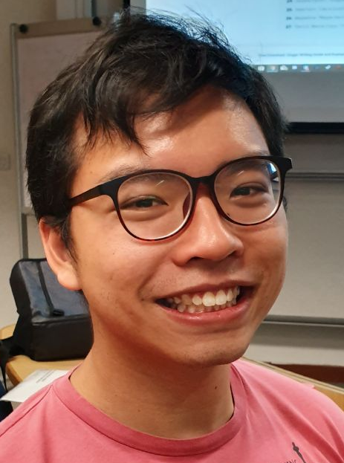
Name: Jeff | Age: 23 |
Major: IS | Freshman
CCA: Rotaract Club
Bio: “I’m in love with cities I’ve never been before and people I’ve never met”
Motivation: Passionate about volunteering, enjoys travelling and meeting new people

Slide 14

Goals
To seek overseas volunteering opportunities (OCSP)
Frustrations
Excessive emails
Information for relevant OCSP crowded out due to excessive repeated email advertisements
OCSP information not readily available

Slide 15
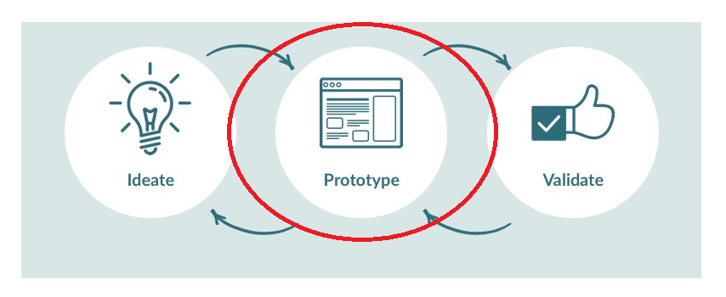
Prototype

Slide 16
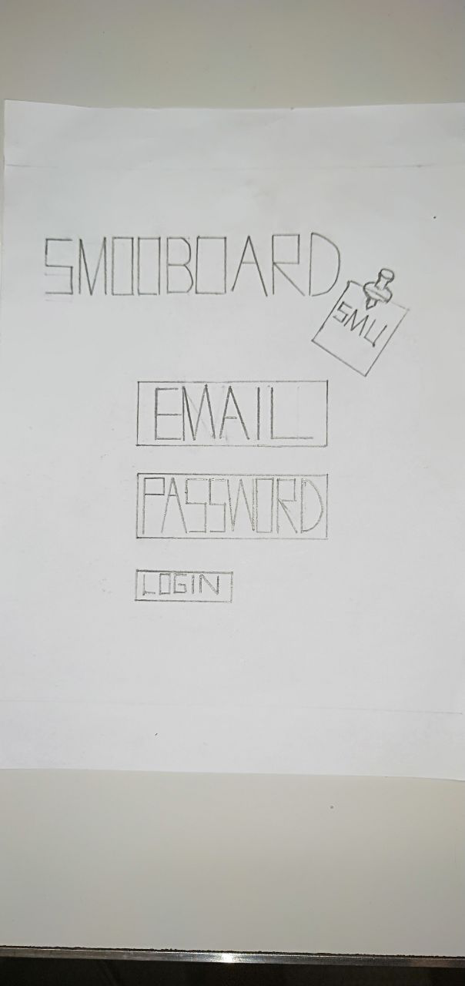
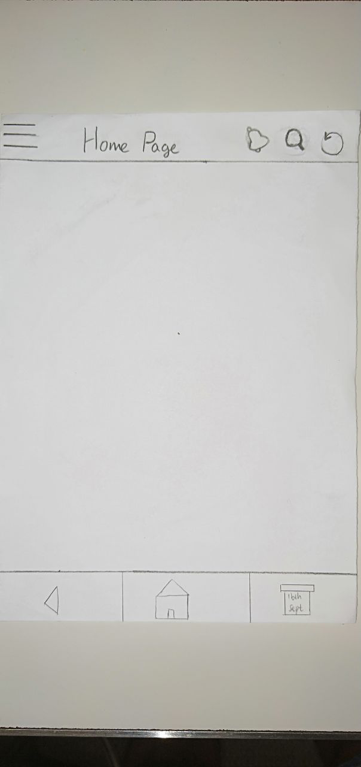

Slide 17
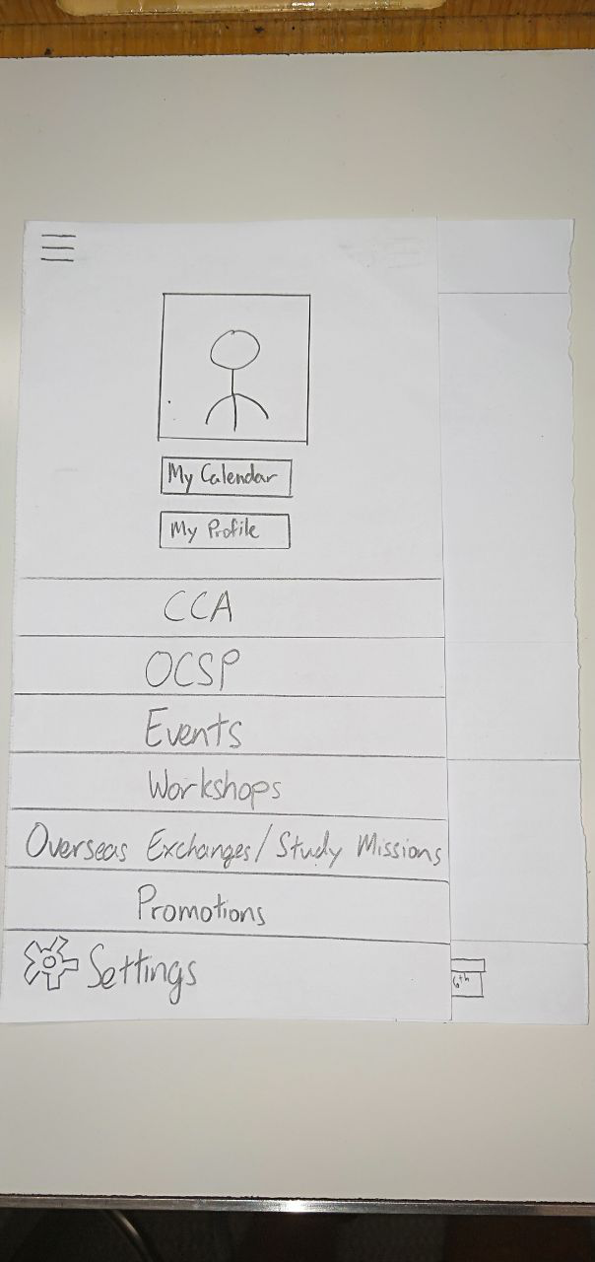
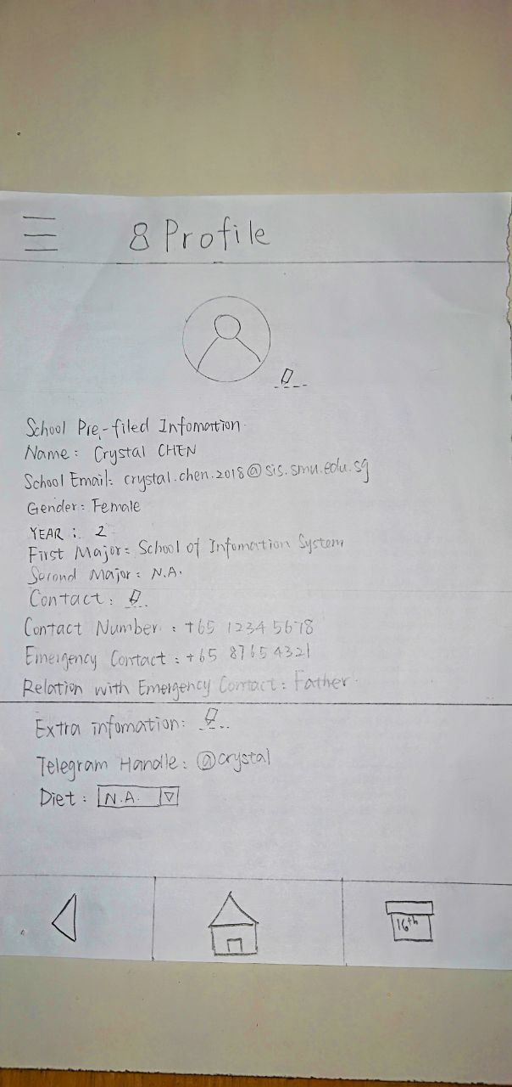

Slide 18
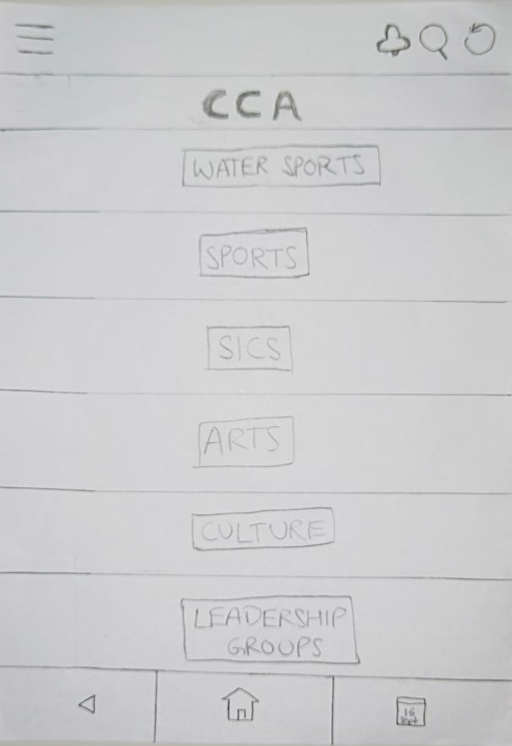

Slide 19
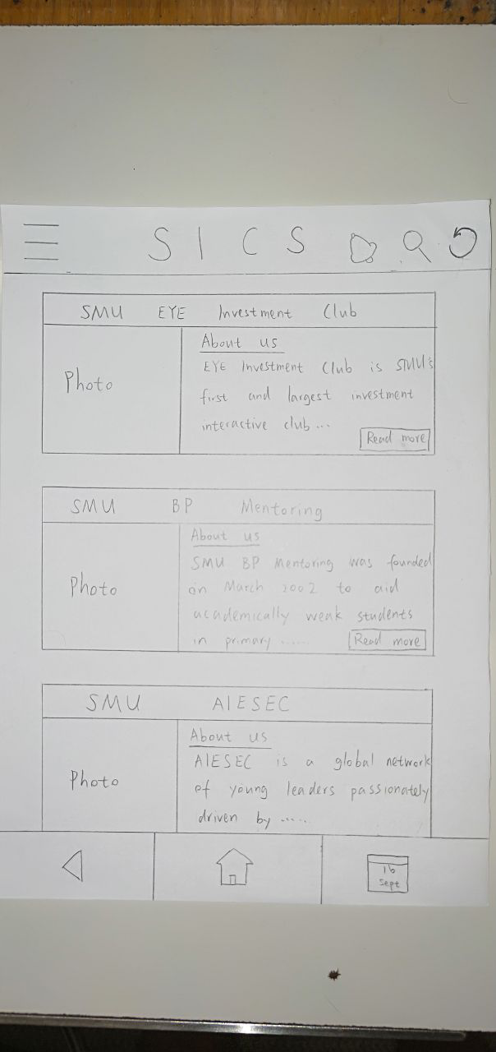
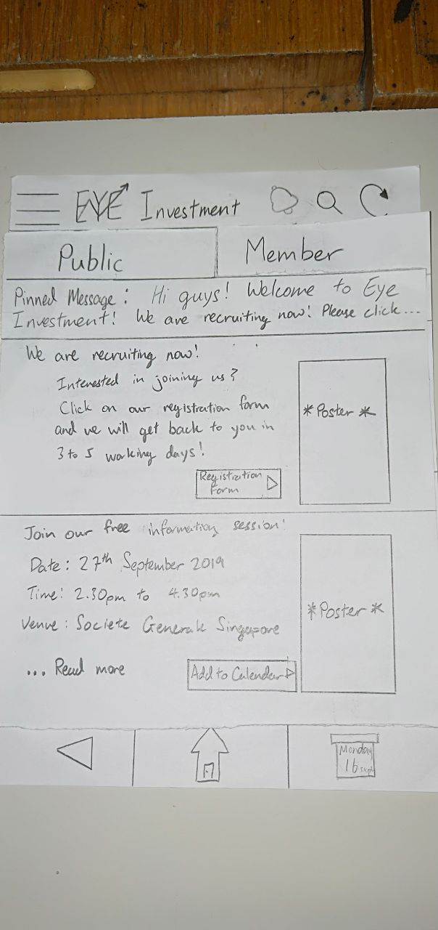

Slide 20
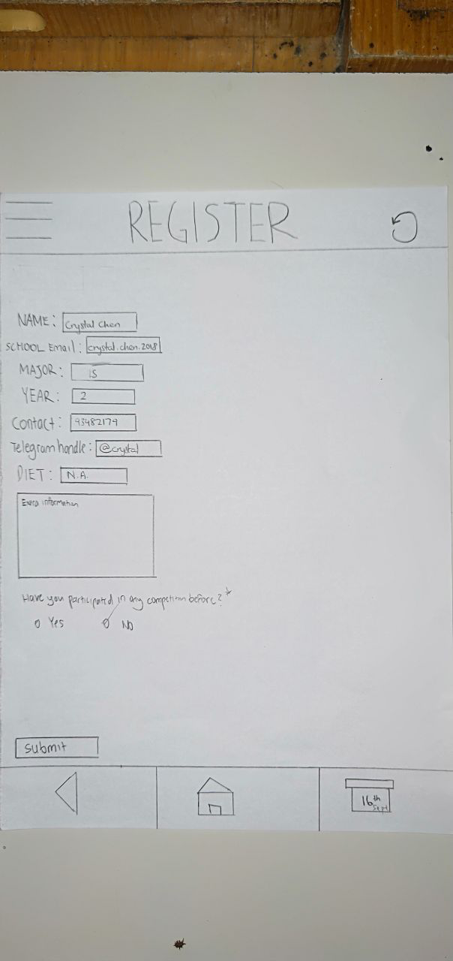
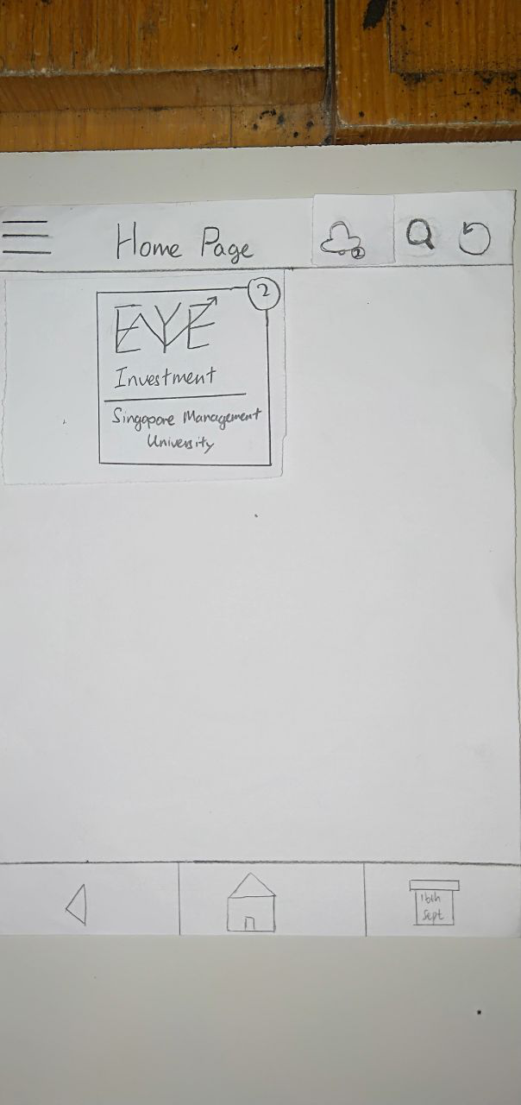

Slide 21
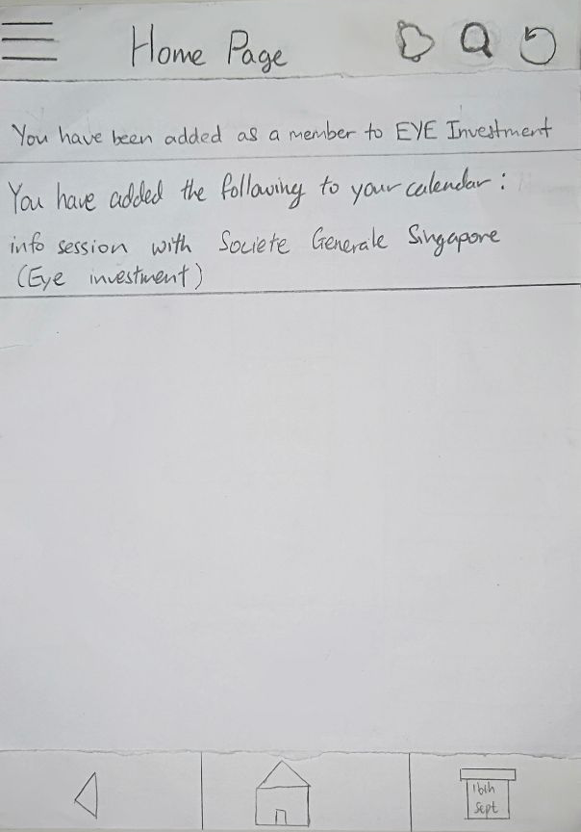
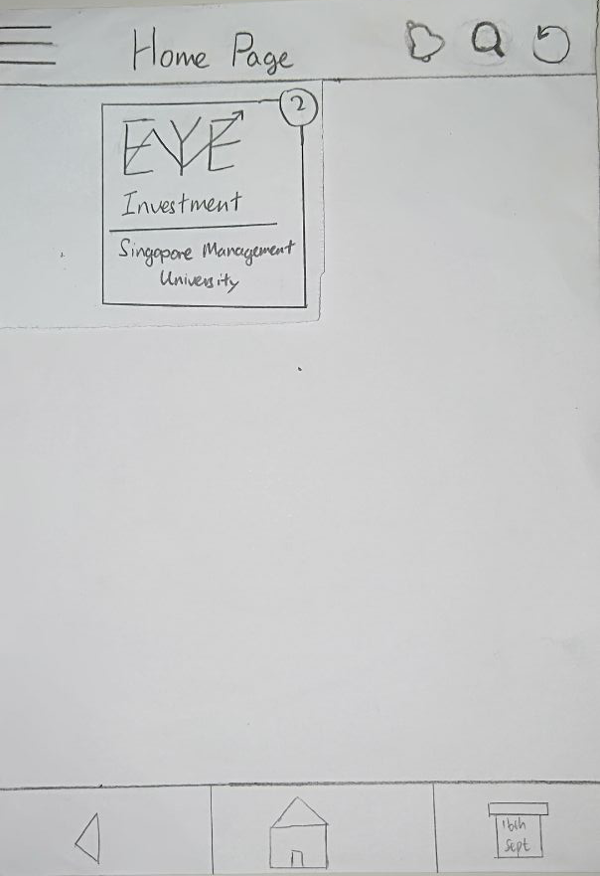

Slide 22
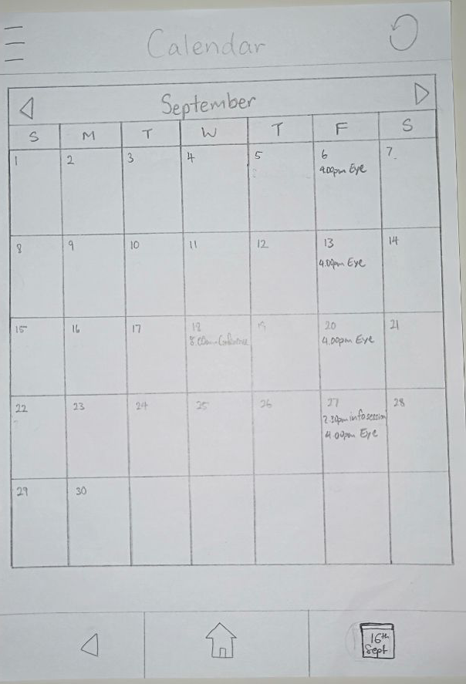
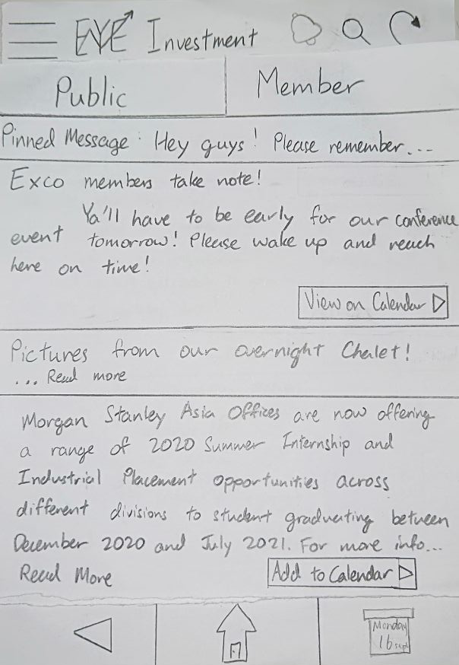

Slide 23
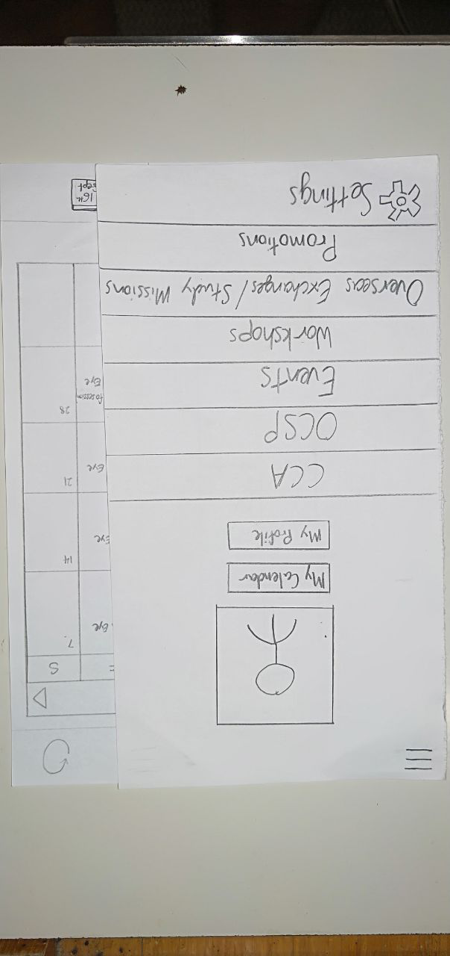
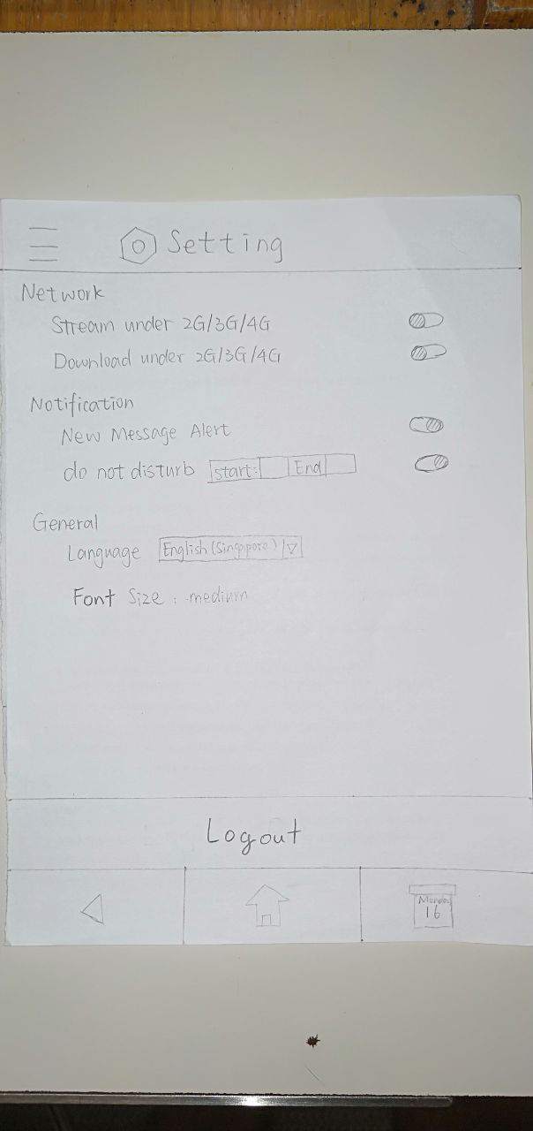

Slide 25
Heuristic Evaluation

Slide 26
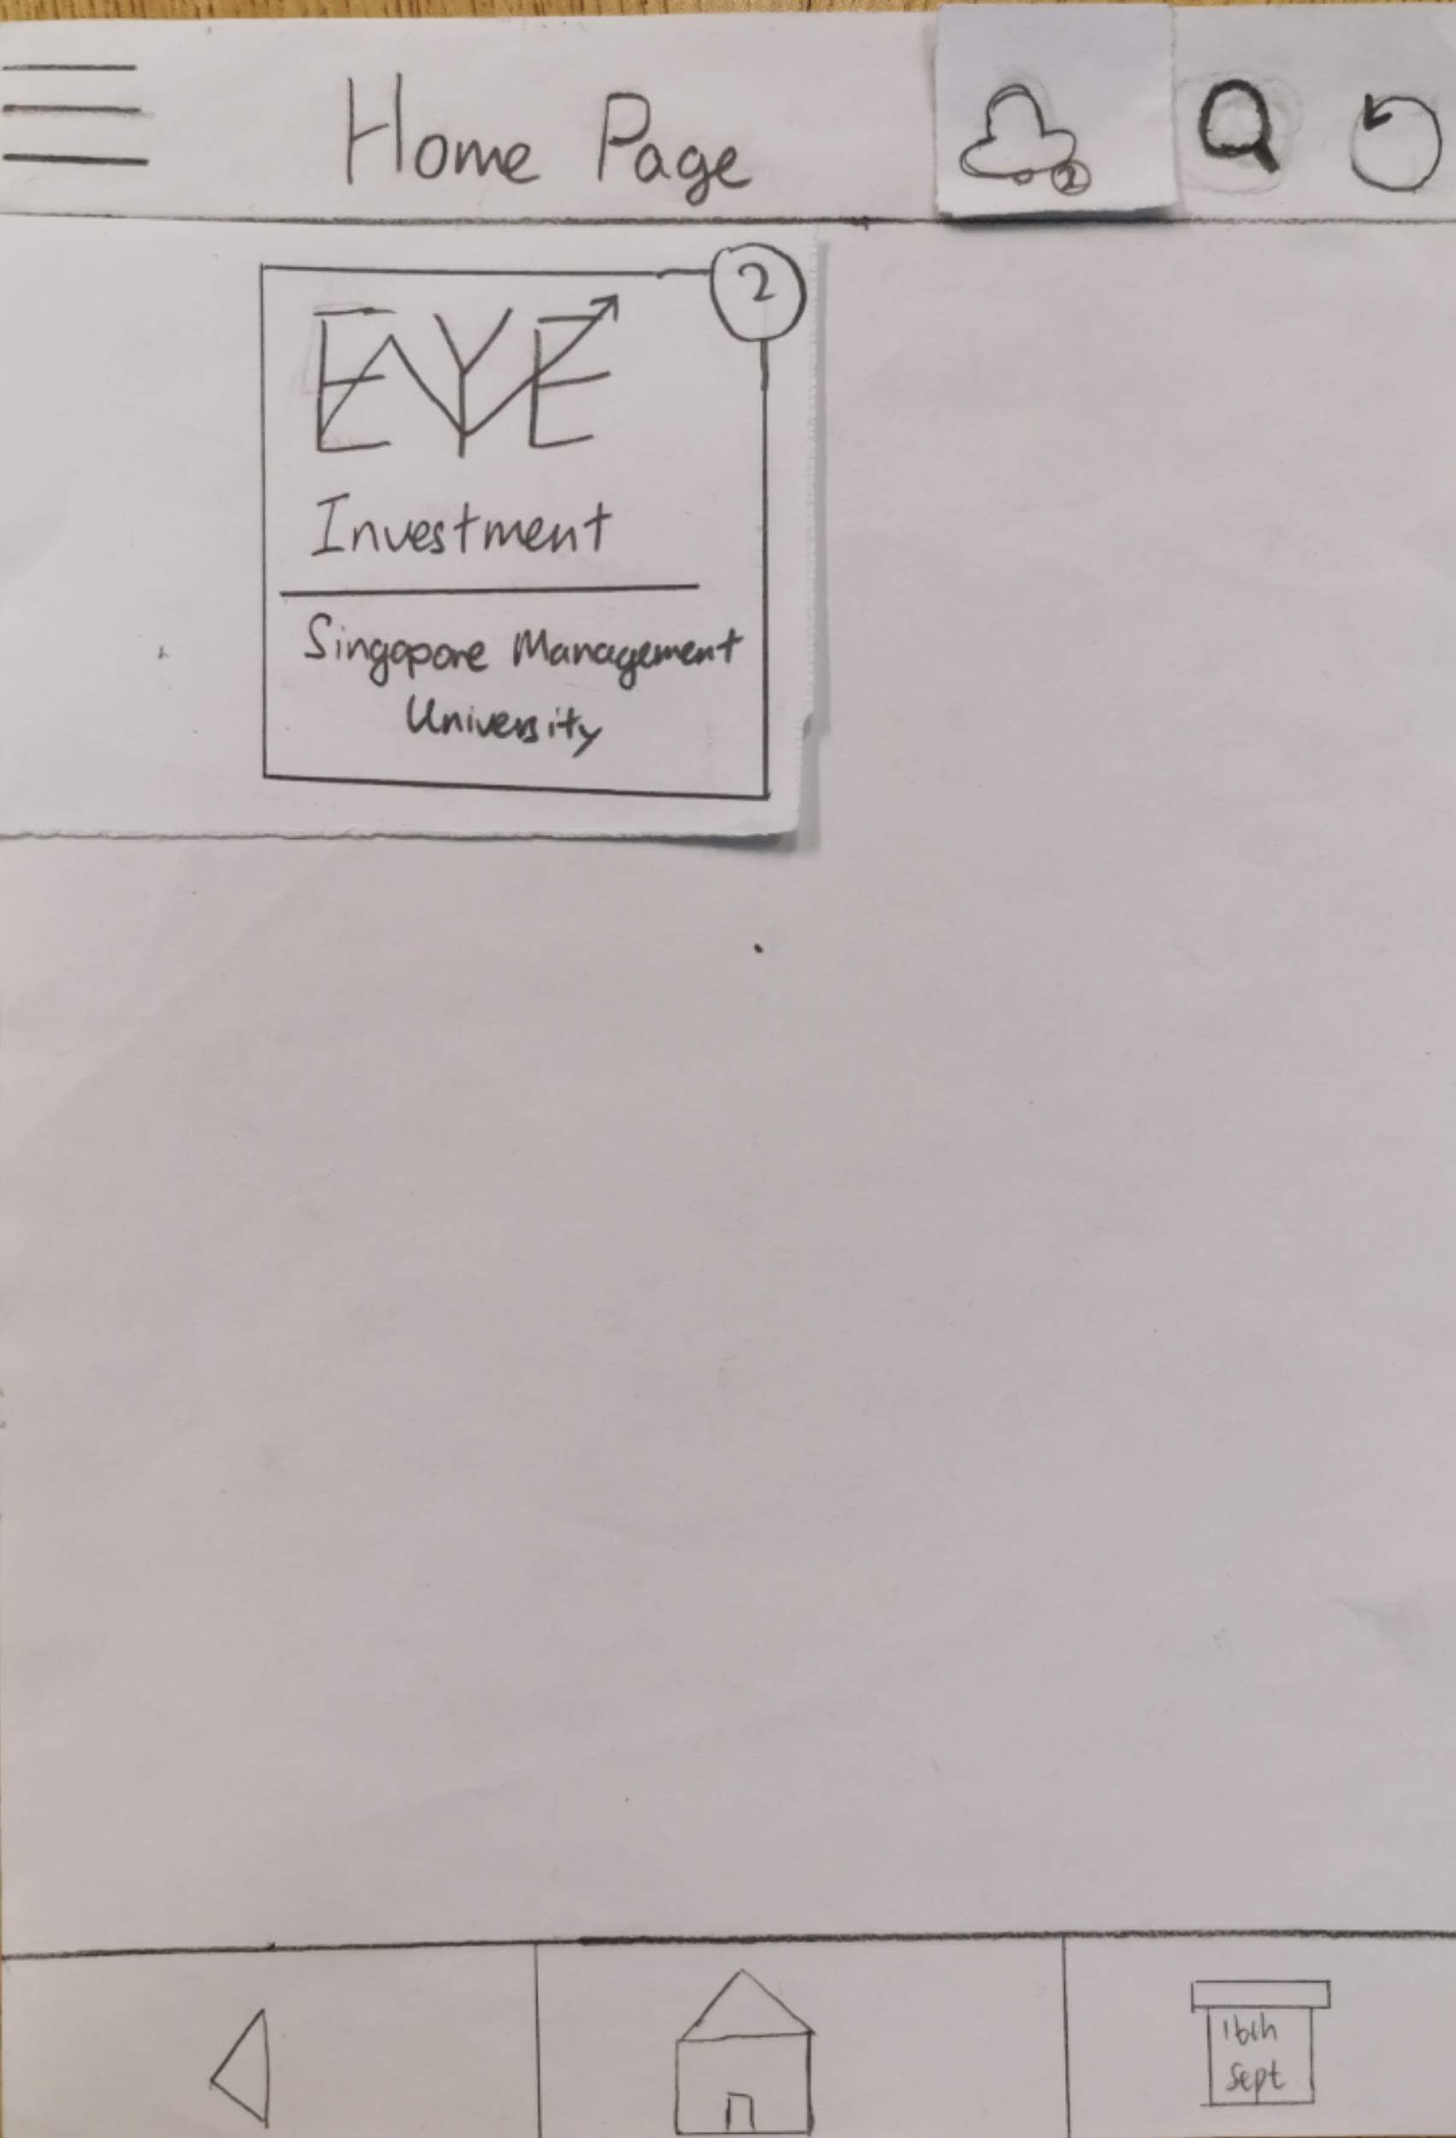
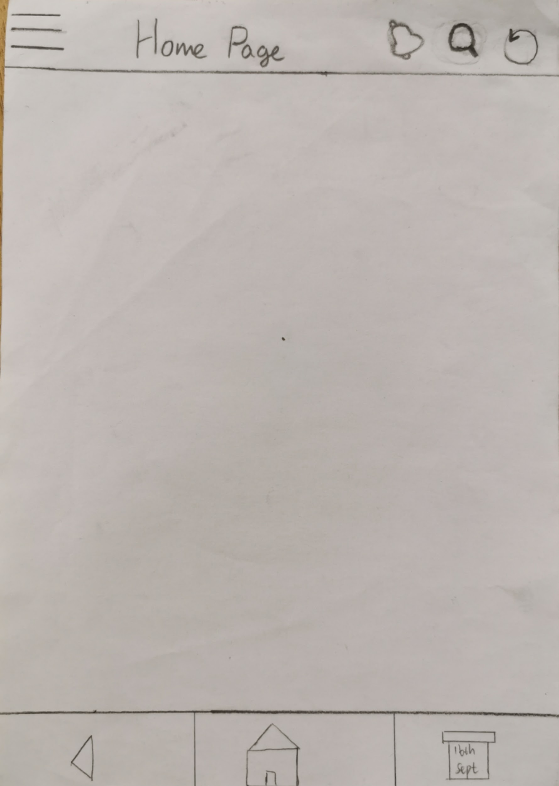
Home page:
#10 Help and doc
#3 User control freedom
Navigation bar:
#8 minimise design
#4 Consistency and standards

Slide 27
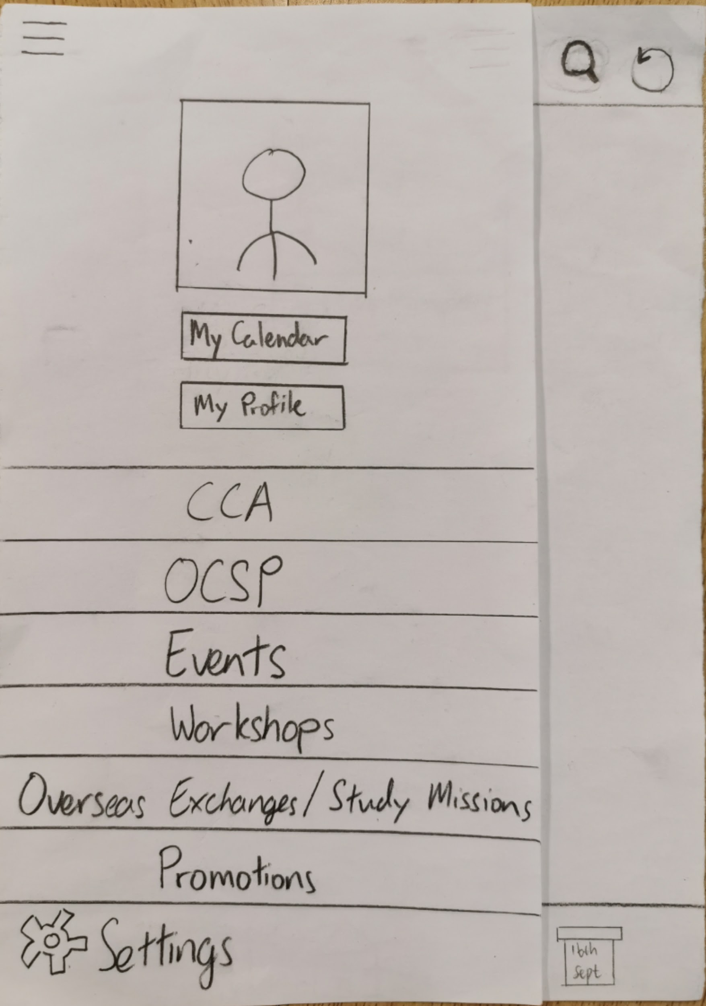
Side bar:
#4 Consistency and standards
#8 Minimise design
#7 Flexibility and efficiency of use

Slide 28
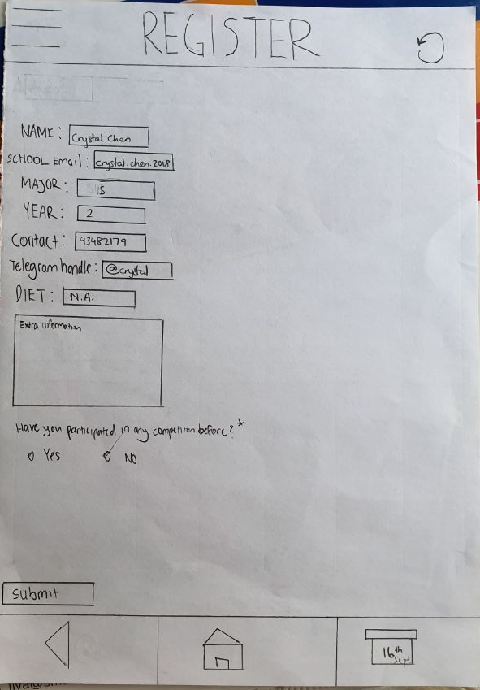
Registration form:
#5 Error prevention
#1 Visibility of system

Slide 29
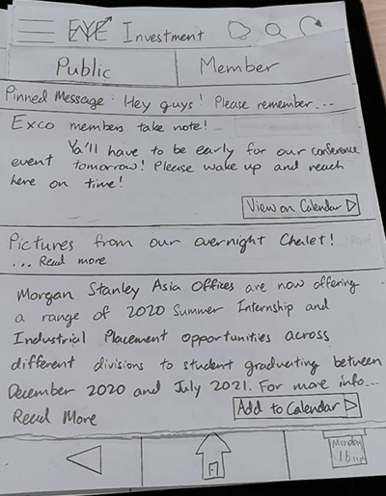
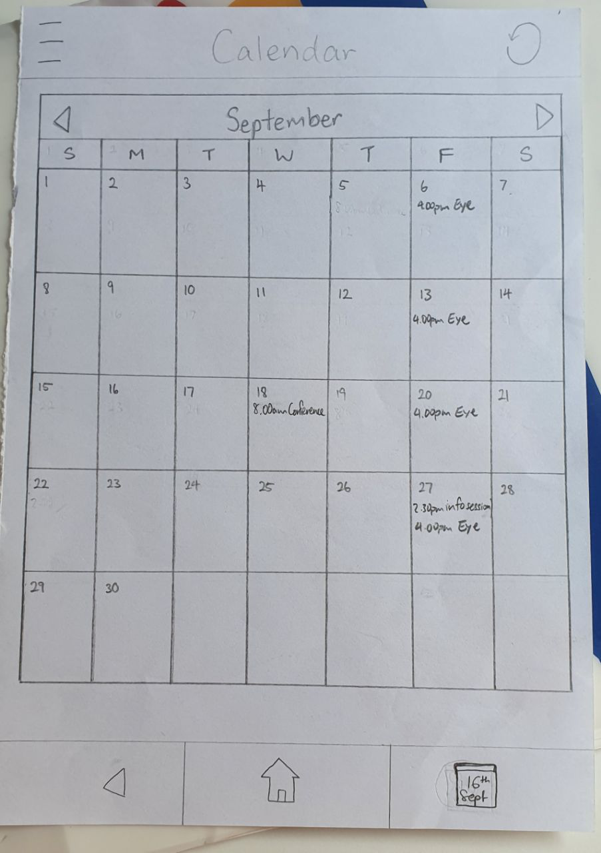
CCA page
#1 Visibility of system status
Calendar page
#5 Error prevention

Slide 30
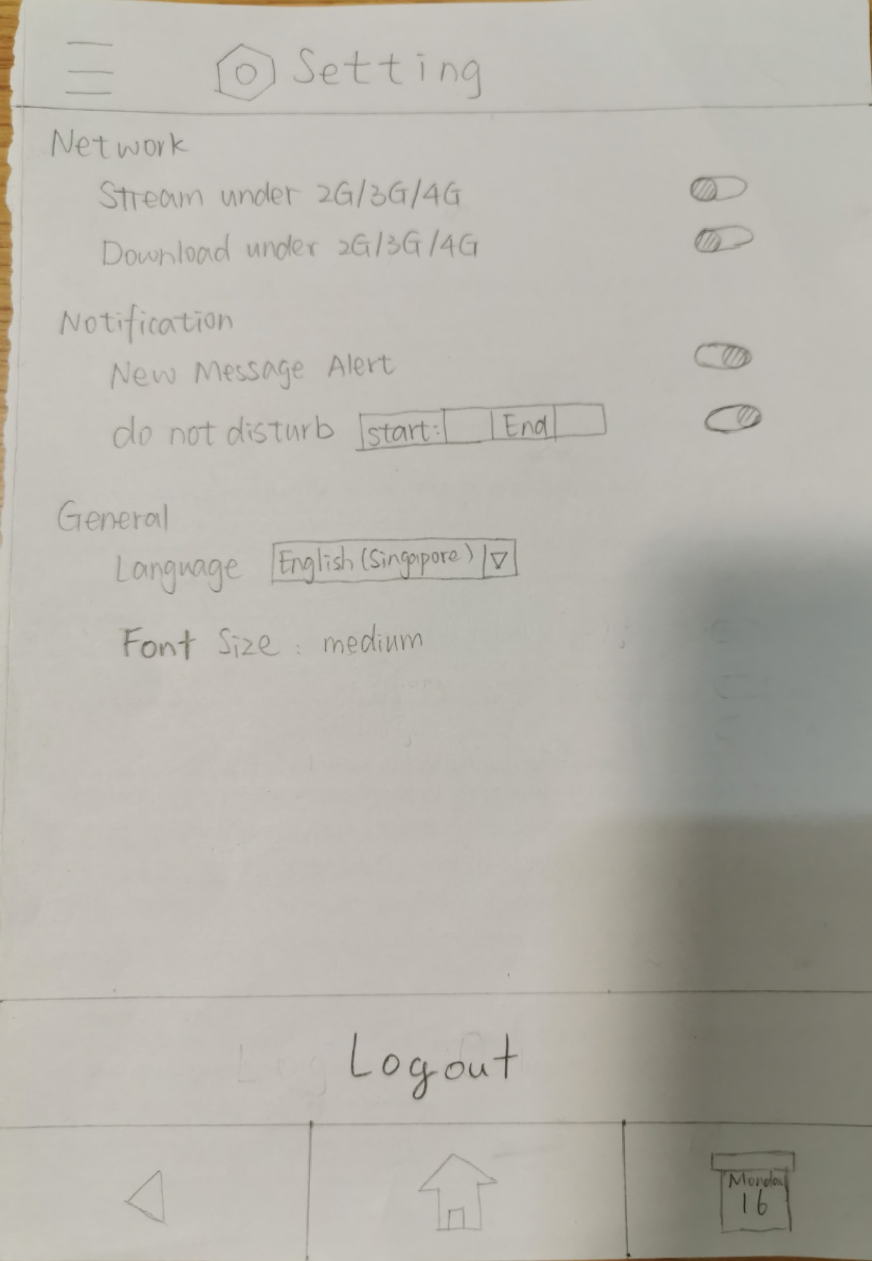
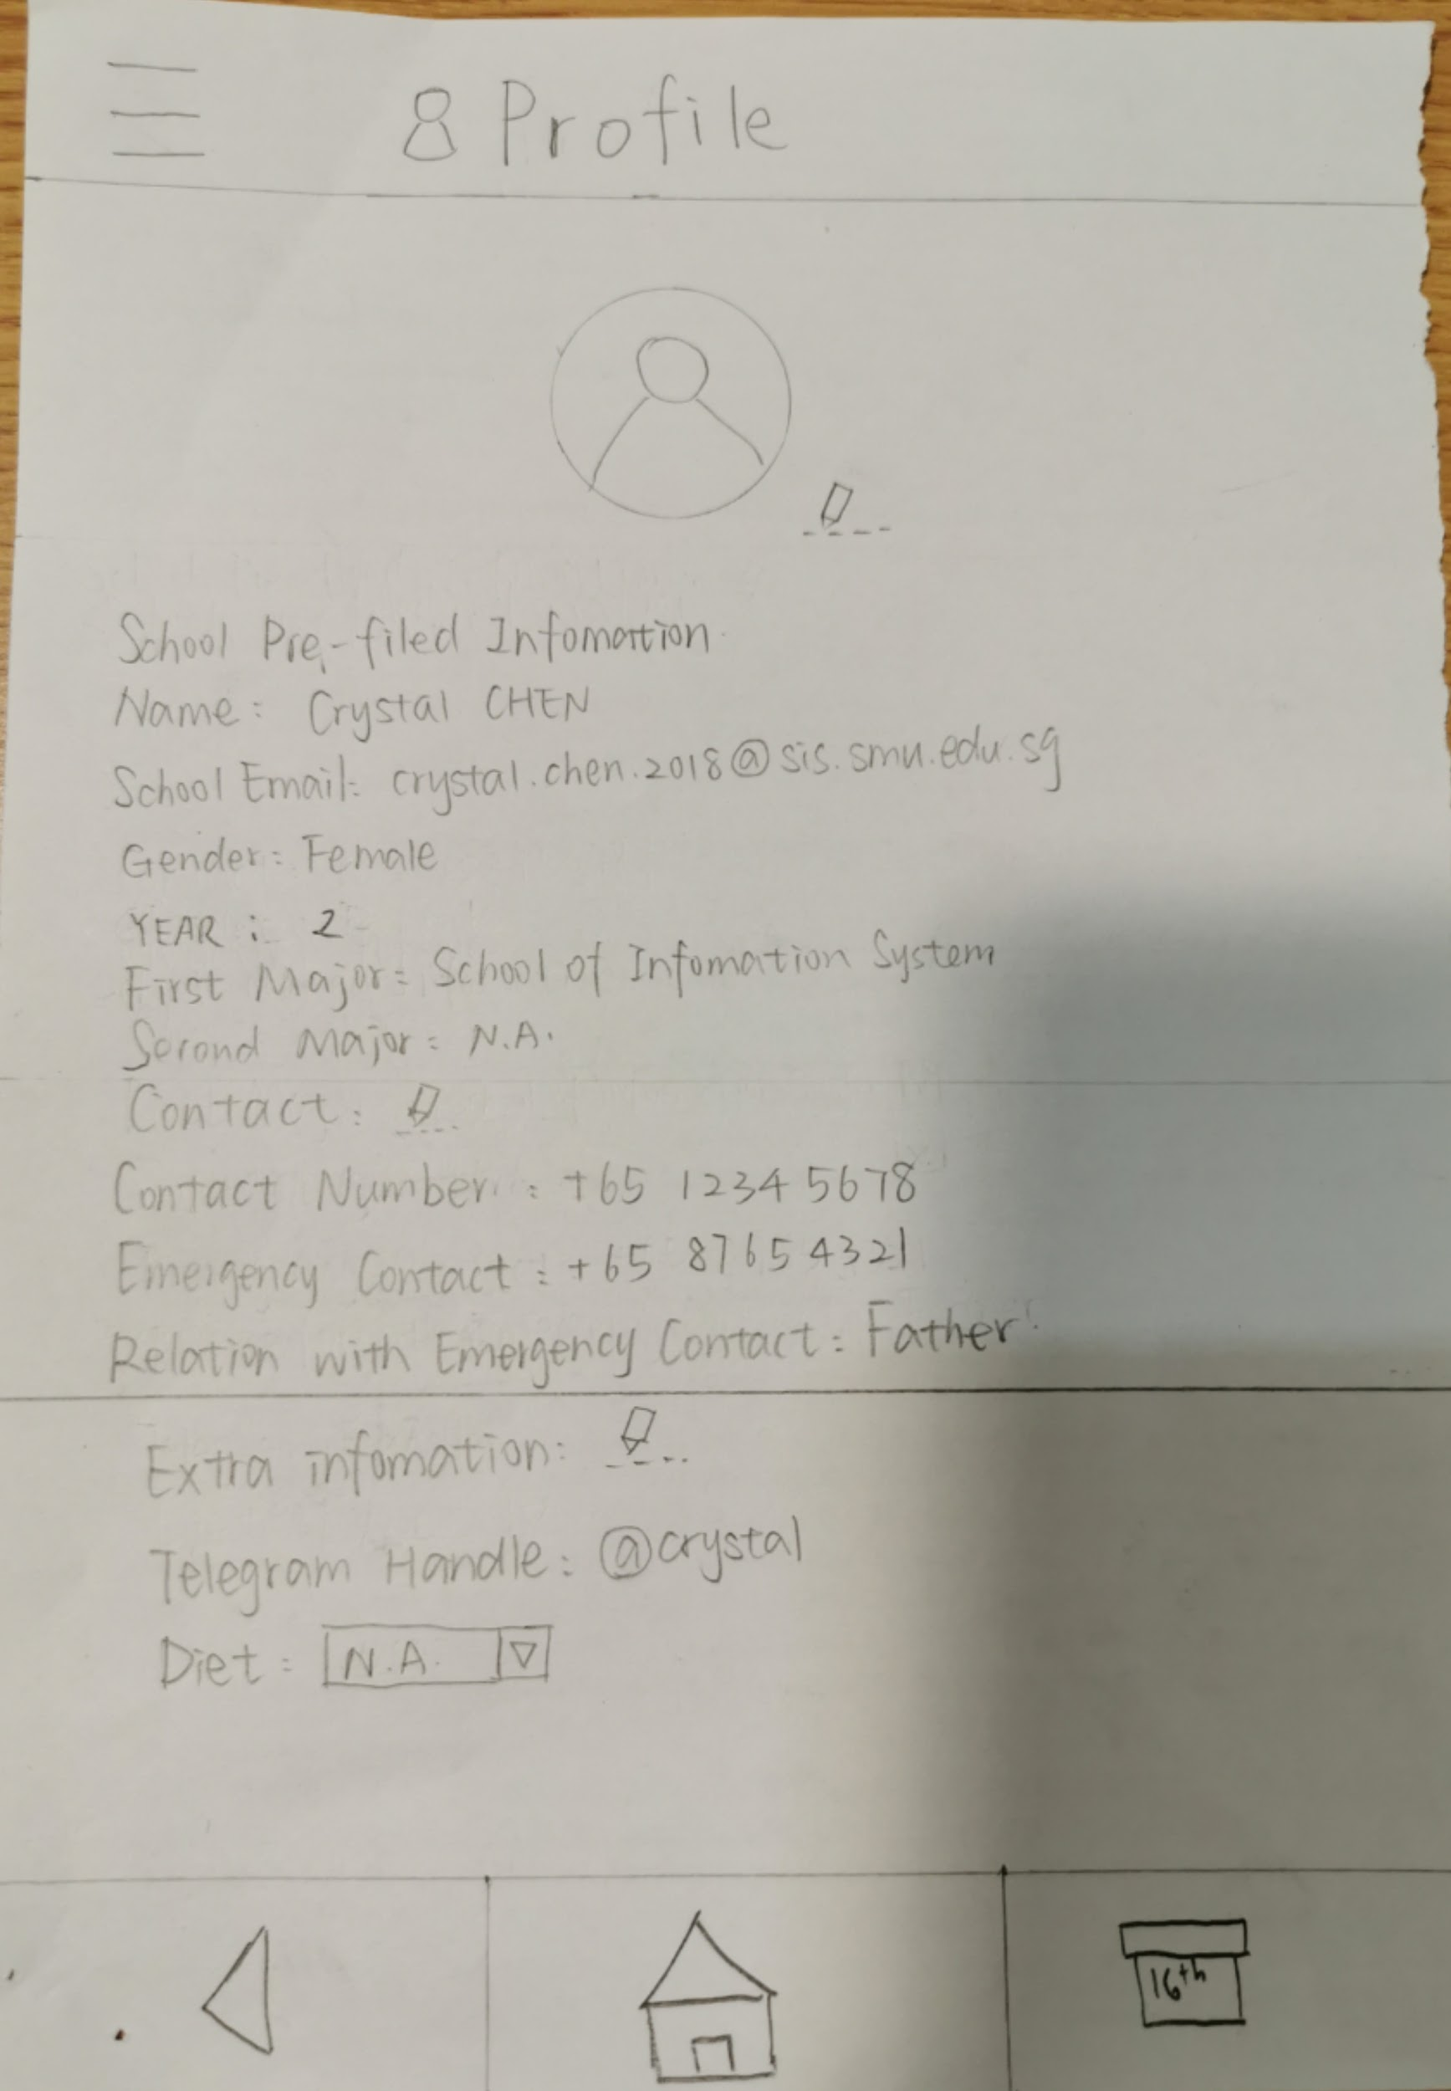
Settings and profile
#1 Visibility of system status

Slide 31
Thank you

